Slide 1
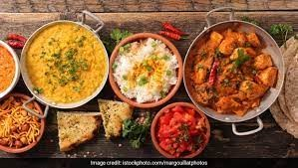

FOOD CONSUMPTION IN INDIA
SANDRINE PREVOT
FEB, 11th | PARIS
DAFT NOV21

Slide 2
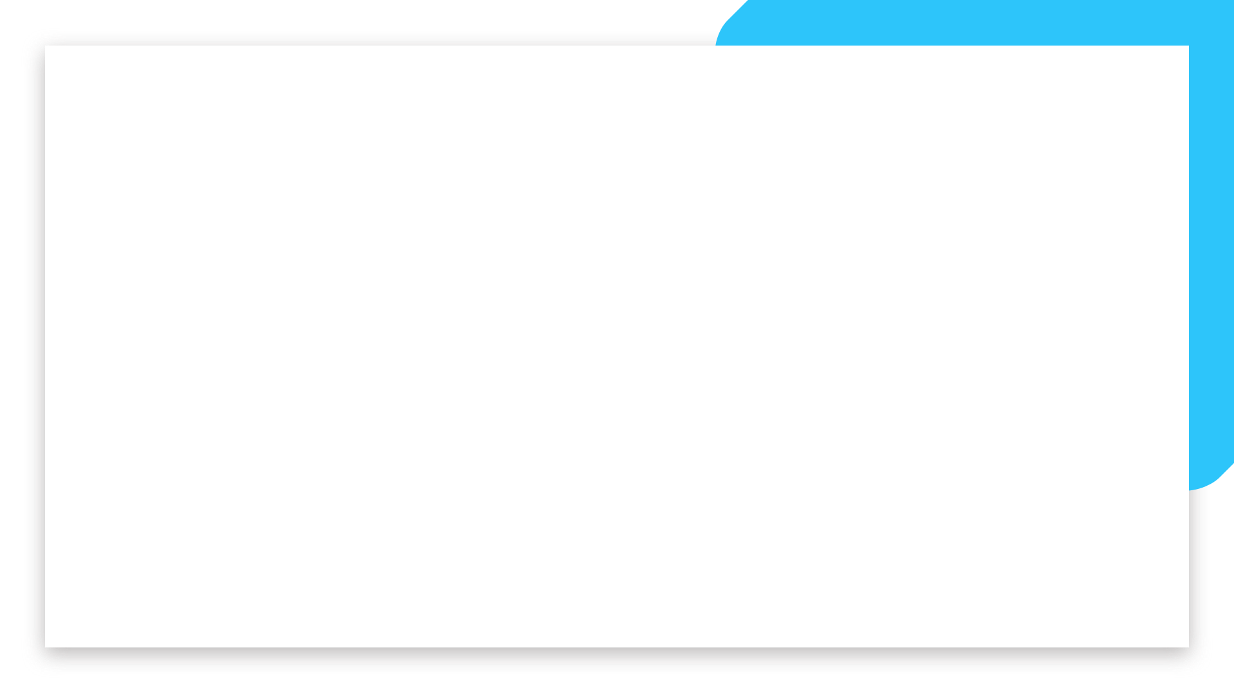
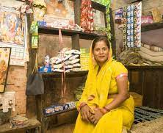
Business case
Domain: Consumer research
Analysis will be an indicator of level of living and of the responsiveness of demand.
The link with social background permit a better understanding of the consumer.
There is a political issue: in a context of Hindu nationalism, the religion and casts are used for political purposes in order to divide Indians (the stigmatization is based food consumption)
The objective will be to see whether social characteristics determine consumption behavior or not.

Slide 3
Process
About data
Socio-Economic/Monitoring Survey of NSS
Title: India - Household Consumer Expenditure, NSS 68th Round : July 2011 - June 2012
From : National Sample Survey Office - Ministry of Statistics and Programme Implementation(MOSPI),Government of India.
Data Loading
Data cleaning
EDA
Encode non-numeric data
Clusters Investigations
Model Evaluation
Model implementation

Slide 4
Cleaning data
Three datasets:
Household: Shape (101662, 45)
Household: Shape (101662, 39)
Food expenditure: Shape (5763152, 35)
Build a unique dataset:
Merge on Household ID and features selections: Shape (100497, 33)
Cleaning
Rename labels of columns
Build a new classification with filter creation on food items
Check for duplicates/ missing value
In numeric columns, exclude outliers
In non-numeric columns, drop rows with small numbers of household (ex: 'Zoroastrianism)
Check collinearity

Slide 5
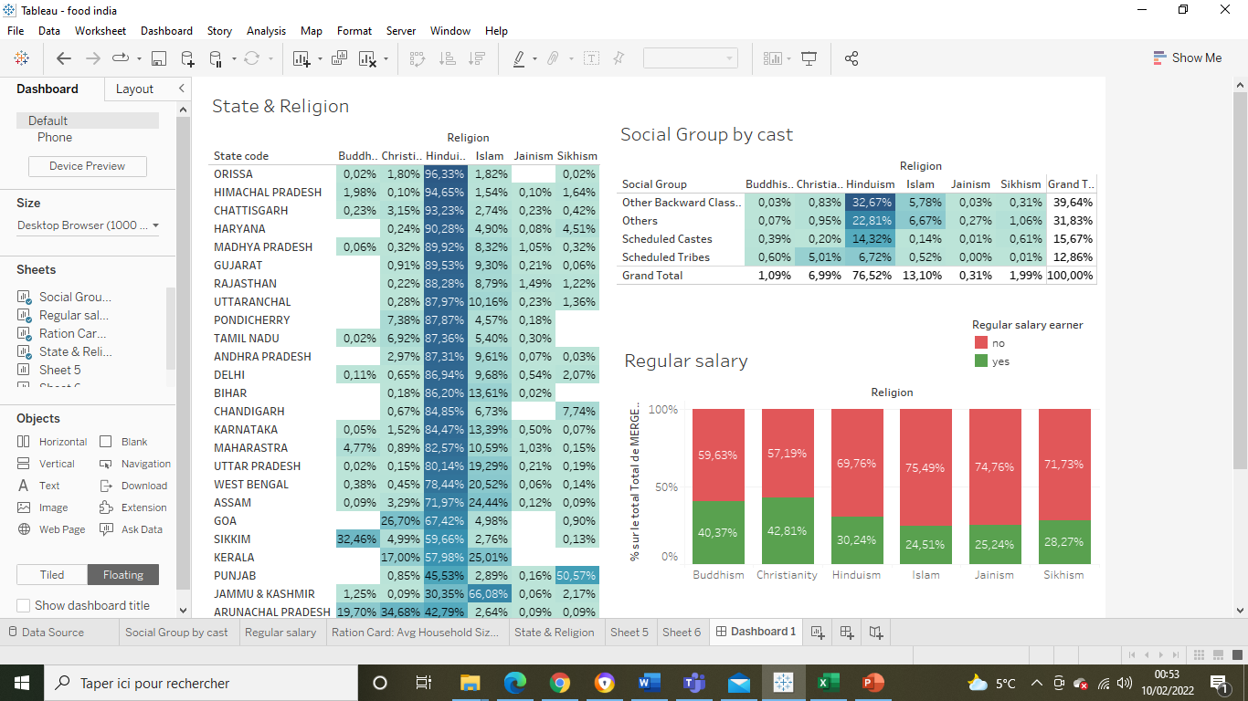
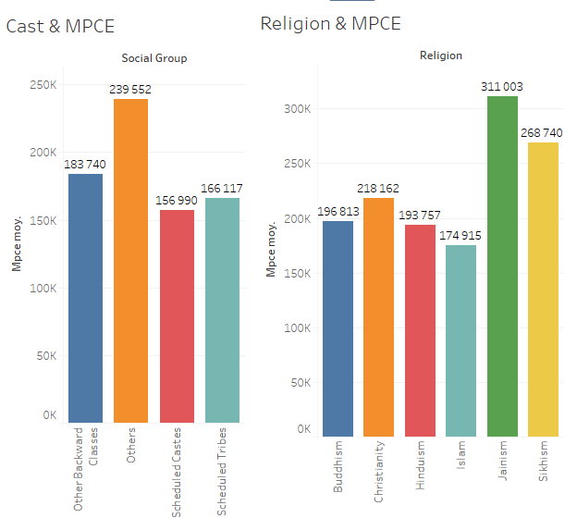
EDA

Slide 6
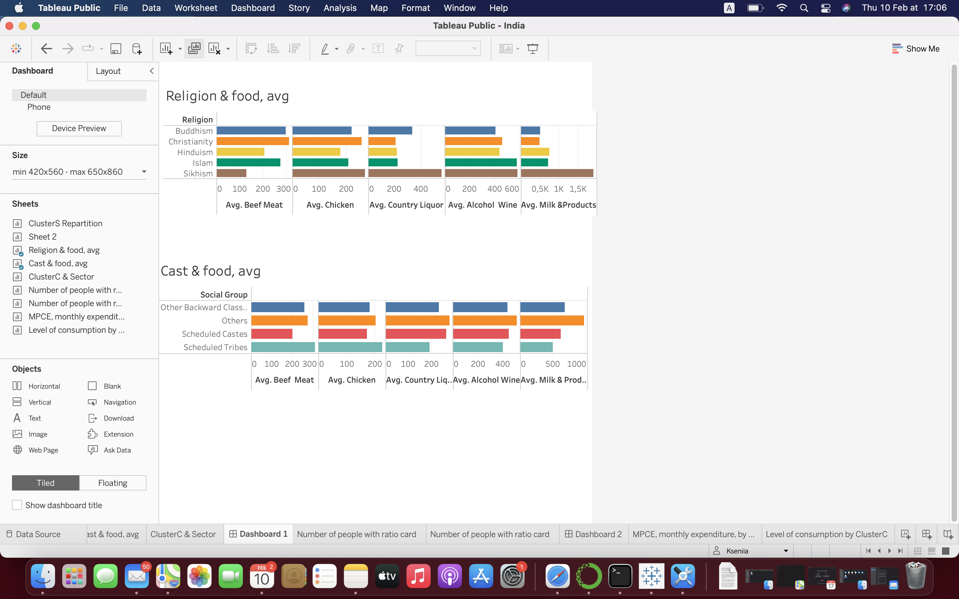
EDA

Slide 7
UNSUPERVISE MODEL
24 columns to cluster
PCA:
Principal Component Analysis (PCA) is used for dimensionality reduction in machine learning.
PCA is used to filter noisy datasets, such as image compression.
KMEANS: Unsupervised machine learning algorithms
k-means clustering tries to group similar kinds of items in form of clusters. It finds the similarity between the items and groups them into the clusters.
K-means clustering algorithm works in three steps:
Select the k values.
Initialize the centroids.
Select the group and find the average

Slide 8
MODELS COMPARAISON
 | Optimum of clusters | Score Silhouette
KMEANS KElbowVisualizer(k = (2,5), metric='silhouette') | 2 | 0,623
AGGLOMERATIVE KElbowVisualizer( k = (2,5), metric='silhouette') | 2 | 0,561
GAUSSIAN (range (2,6)) | 2 | 0.620
DBSCAN (eps in range (1,5)&min_samples in range (2,5)) | 2 ( or 68) | -0.170 ( or -0.939)

Slide 9
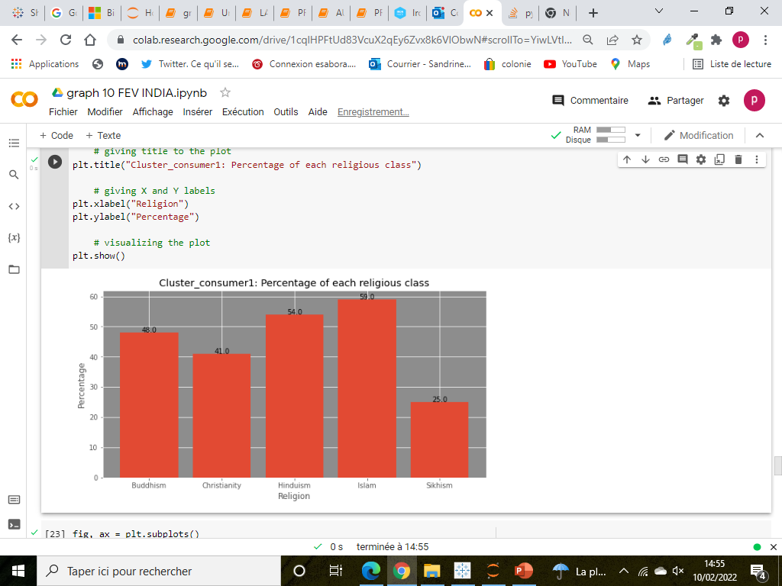
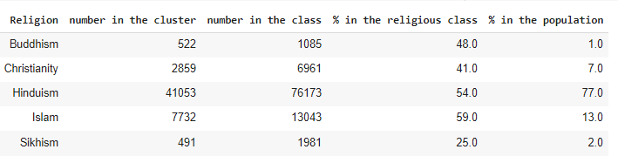
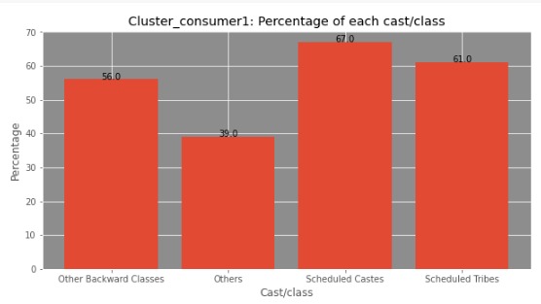
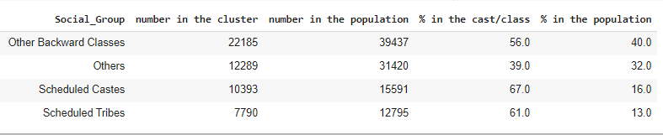
CLUSTER 1
Main results
Insights:
More Scheduled Castes & Tribes (respectively 67% and 61%)
More Muslims (59% of muslims in cluster1)

Slide 10
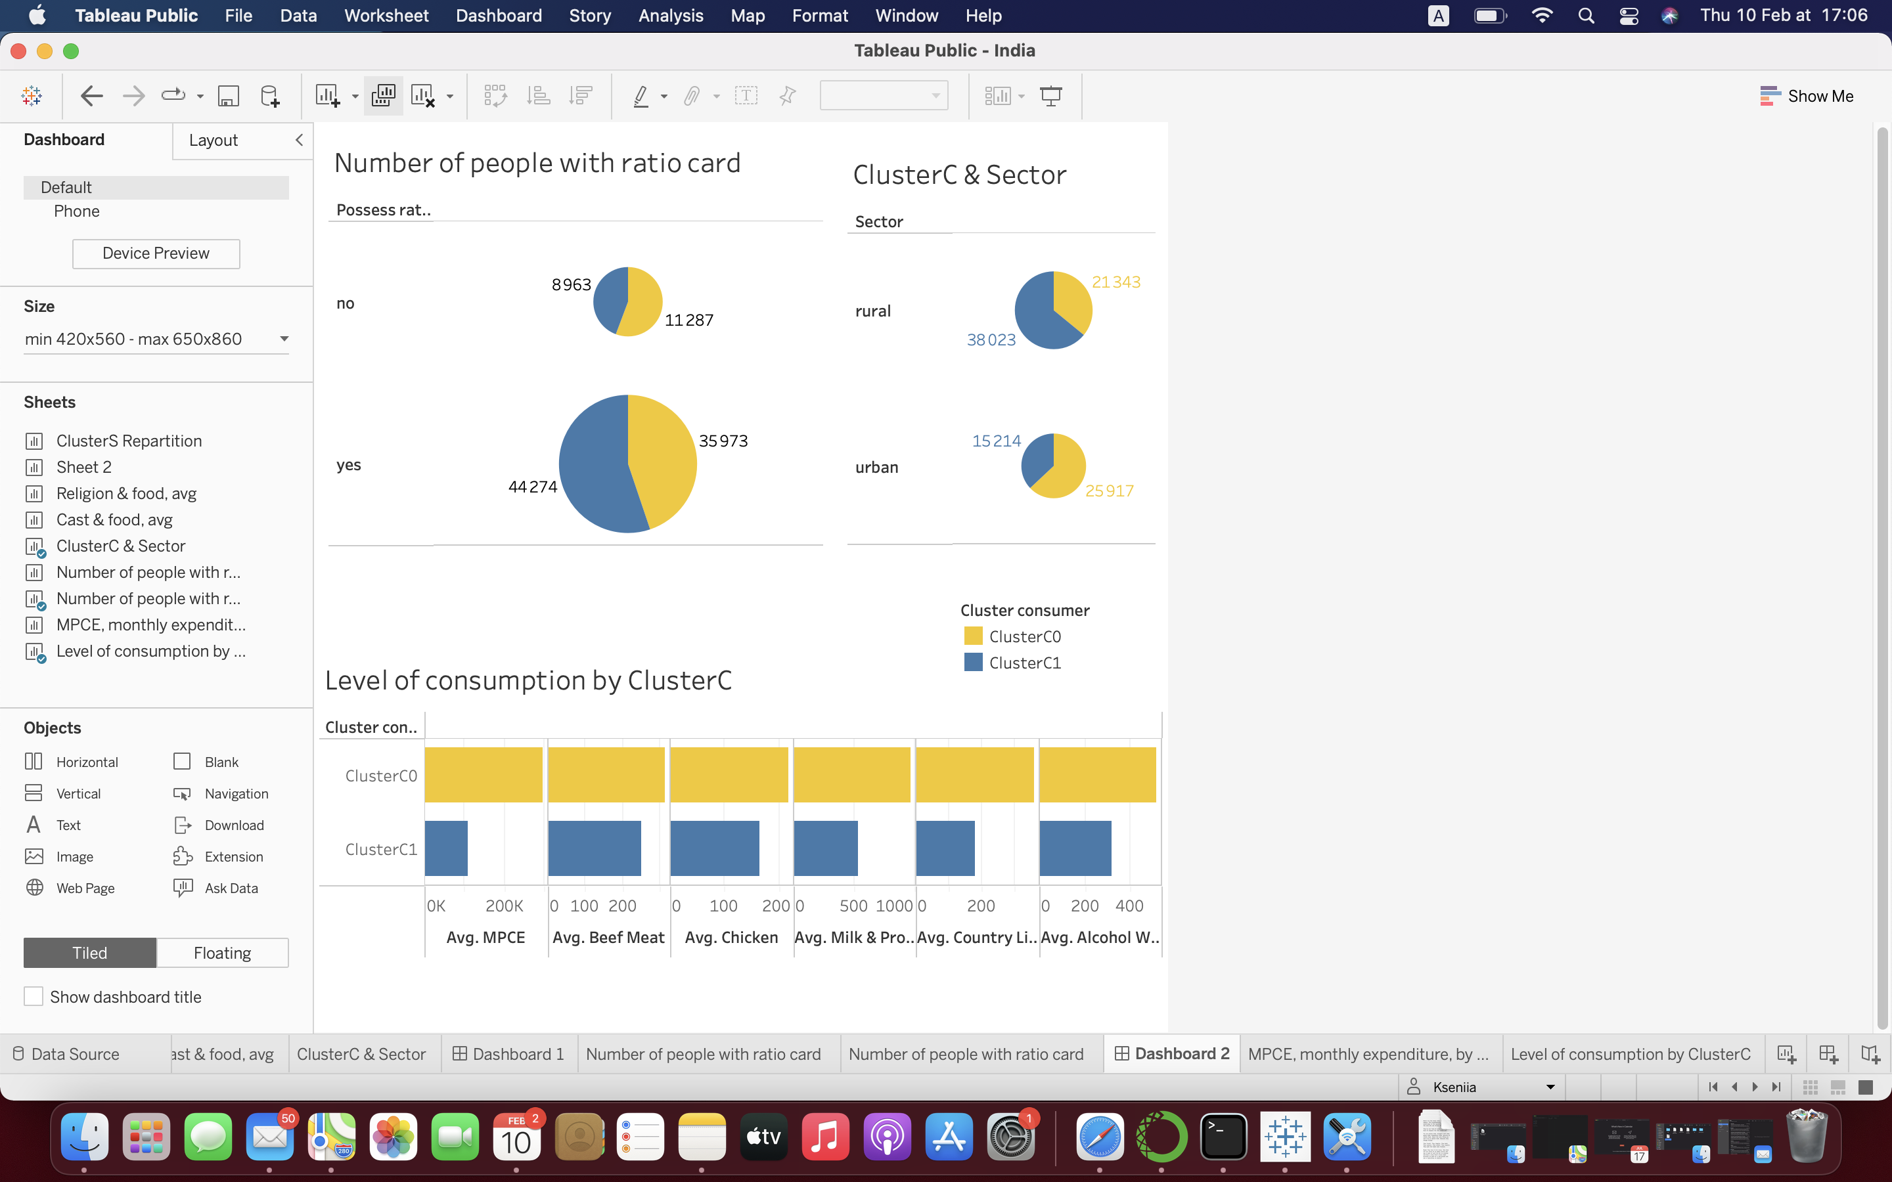
Main results
Cluster1: less money, less food,
More rural, with ratio card

Slide 11
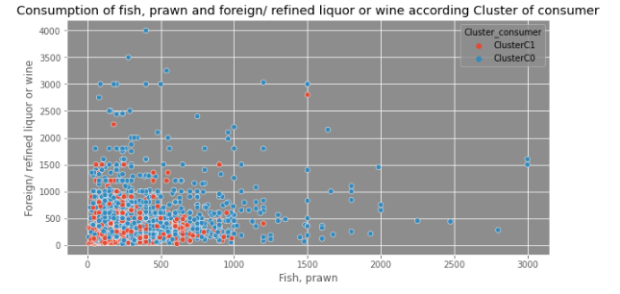
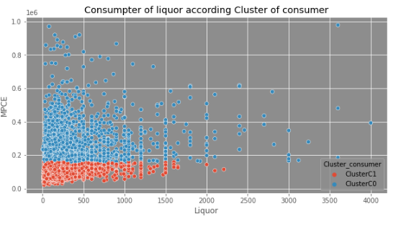
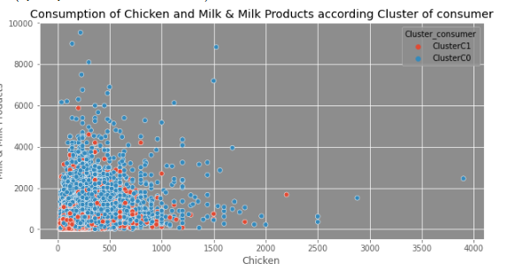
Main results
The main difference seems to be based on level of revenu
The one who is poor and eats less is in majority from scheduled caste, Tribes and live more in rural sector
There is no difference of the structure of food consumption related to the cast or religion values ( when they have the same level of expenditure, the consumption is the same, whatever you are hindou, muslim, bouddhist, christian, hight cast or low cast)

